Slide 1
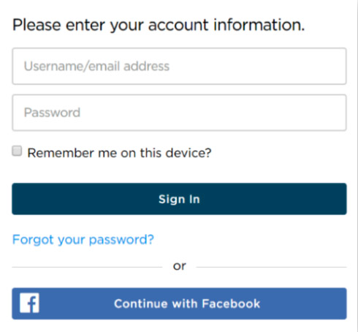
How to Log in
You will login through www.princetonreview.com
and you will need to follow the login convention described below:
Username: The email address with which you were registered by your school.
Password: Everyone’s default password is “welcome” (case sensitive). You can change it in your account settings after you log in for the first time
Username: your email address
Password: welcome

Slide 2


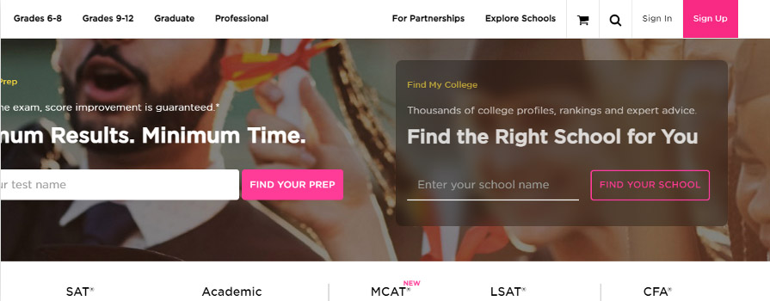
Princetonreview.com
Use 'Sign in', not 'Sign up' to log into your Portal!
!
PRO TIP
We've found that Chrome is the best browser for utilizing Student Portals. You can download the browser here: https://www.google.com/chrome/

Slide 3
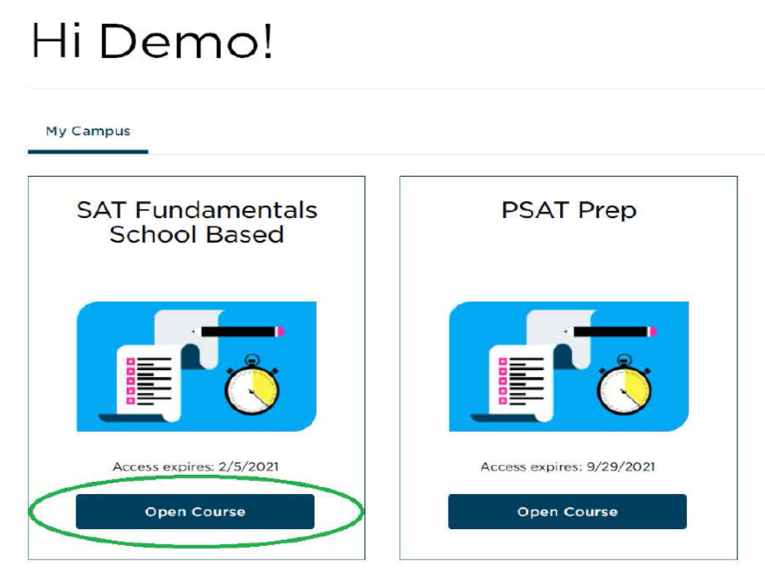
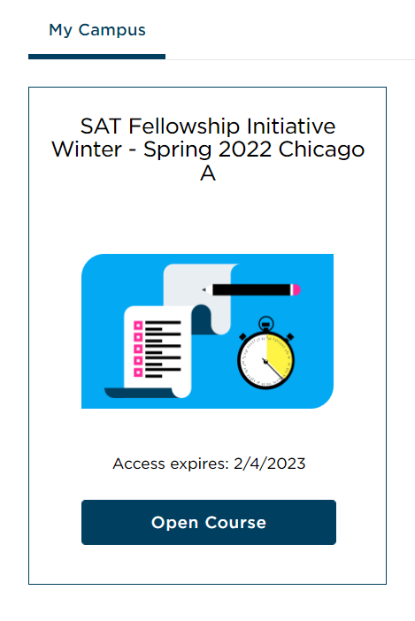
When You Sign In…
You will have access to many materials and important information about your self-paced program!
Click on Open Course under SAT Self-Paced- Program Name-Year (you will see the name of your program and year of study instead)
to get to the Online Student Portal.
SAT Self-Paced
!
PRO TIP
Use your Portal throughout the calendar year to prepare for your official ACT!

Slide 4

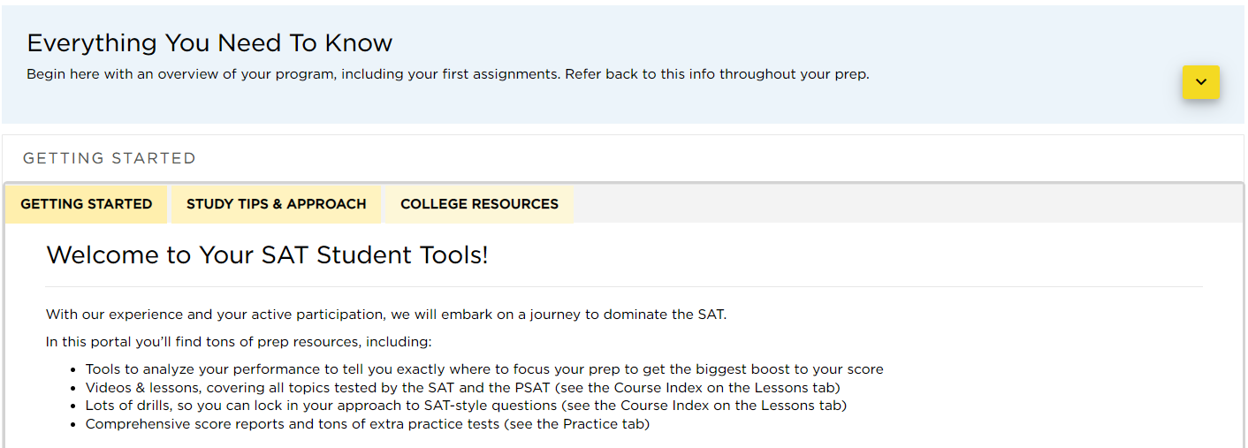
Home Page
Start by going through the dropdown sections Everything You Need To Know and Getting Started.
Here you will find your Study Guide, which provides detailed information for making the most of your Self-Paced Portal.
Also check out the "Study Tips & Approach" and "College Resources" tabs.

Slide 5
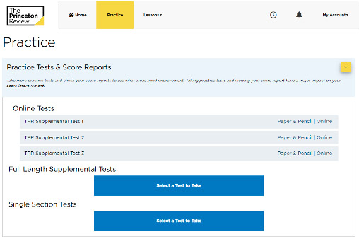
Practice Tab
We recommend that you take a practice test before going any further.
This will help you realistically determine the following:
  your starting score
  which question types you’re ready for and which you might need to practice
  which content topics you are familiar with and which you will want to review
You can find all the practice tests and score reports under the Practice tab at the top of your screen. Click on the down arrow to see the available practice tests. Then click “Online” to begin your first test.

Slide 6
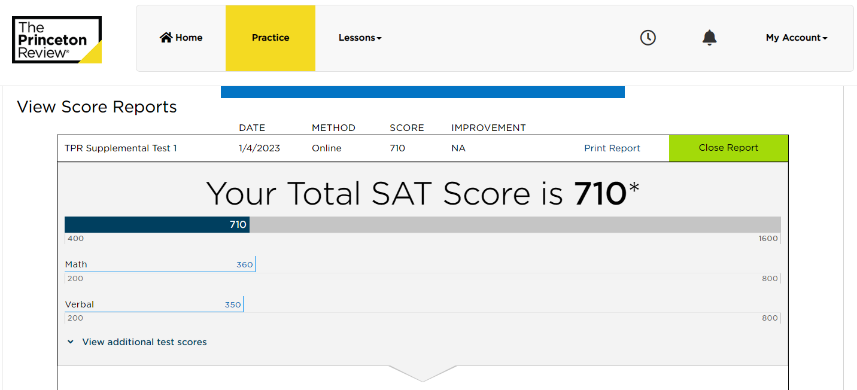
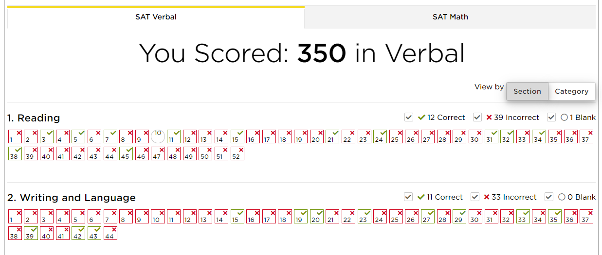
Practice Tab
Once you take a practice test, a comprehensive score report will automatically generate. Click Category to discover the types of questions you need to focus on in your self-paced study.
You can also click on each question for a detailed explanation!

Slide 7
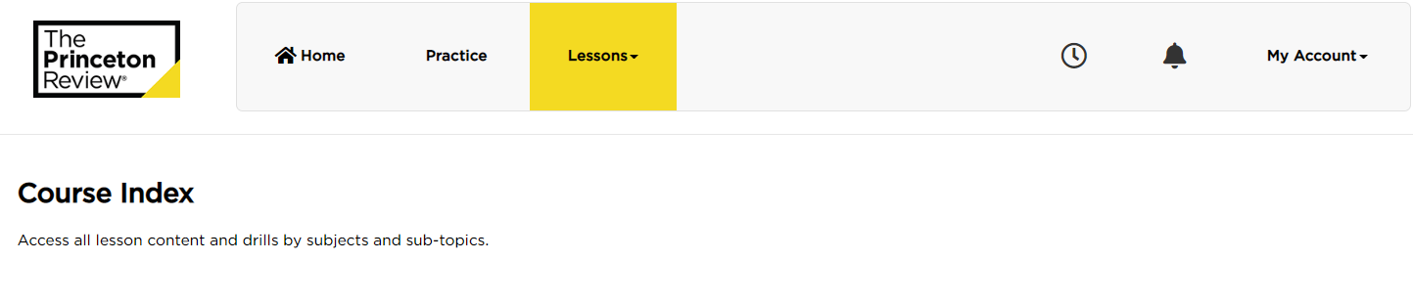
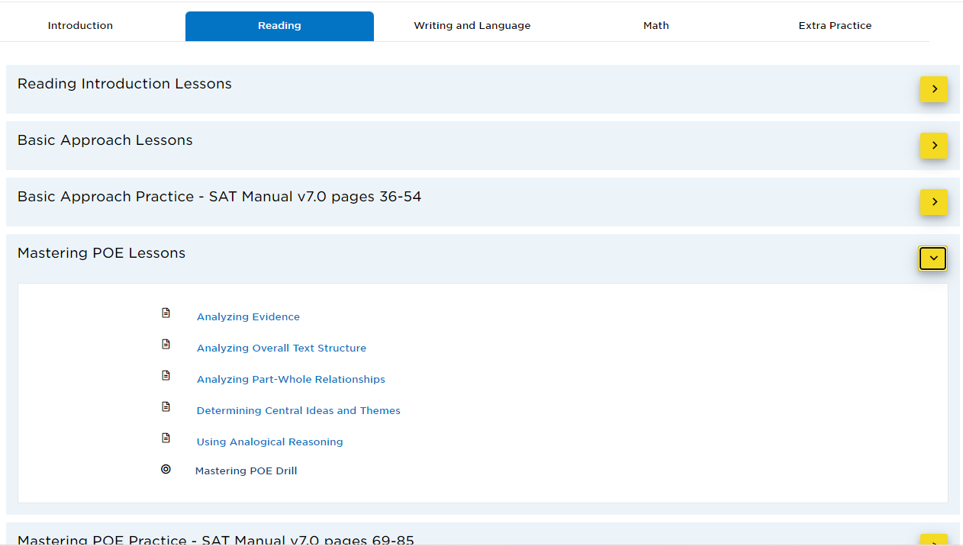
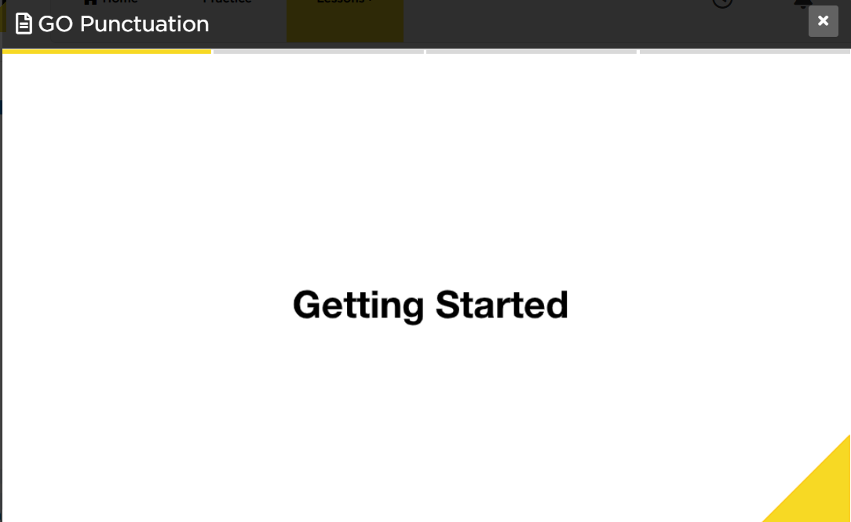

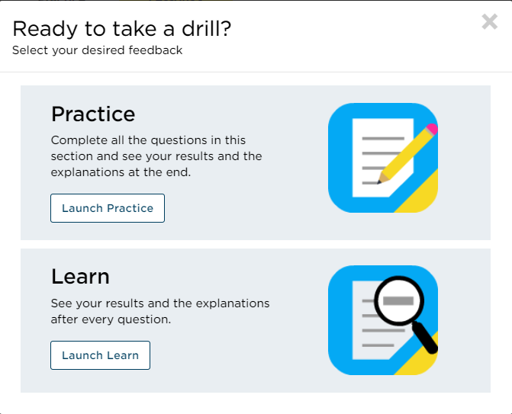

Lessons Tab
The Lessons tab organizes all your lessons by topic:
  Reading
  Writing and Language
  Math
  Extra Practice
Start with the Course Introduction for basic approaches.
Toggle between the tabs to view subtopics. If your score report identifies an area for improvement, we recommend starting there.
When you're ready to test your knowledge, take a drill!
Toggle
Lesson
Drill

