Slide 1
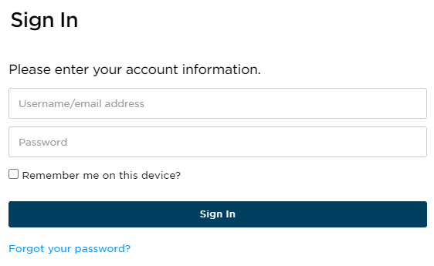


Guide to Your Student Portal
You are enrolled into our test prep course with your email provided by your school as the username.
There will be a link and preset password provided in your Welcome Email that you will use for your first time signing into the Student Portal.

Slide 2


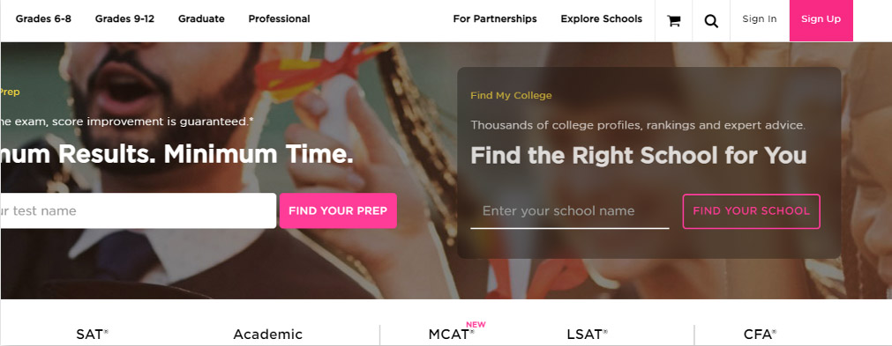
Princetonreview.com
Use Sign In, not Sign Up to log into your Portal!
You may need to redirect to the TPR homepage. Go to Account then Home to launch your course!
!
PRO TIP
We've found that Chrome is the best browser for utilizing Student Portals. You can download the browser here: https://www.google.com/chrome/

Slide 3
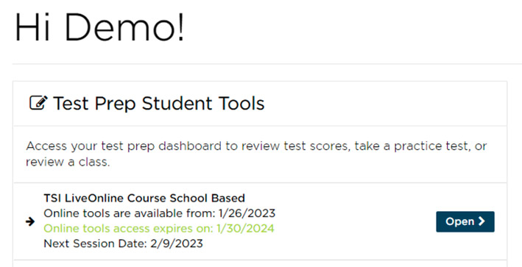
When You Sign In…
You will have access to many materials and important information to guide you through your admissions!
Select Open to get to the Student Portal.
!
PRO TIP:
Bookmark this page for quick access to your Portals.
Be sure to visit them regularly to stay on task!

Slide 4
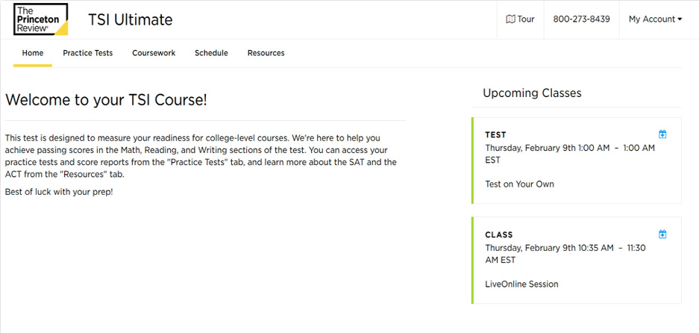
Home Page
Your Home page consists of your online materials, guides, course schedule, and coursework.
Your Home page will have your upcoming classes and any scheduled exams you may have.

Slide 5
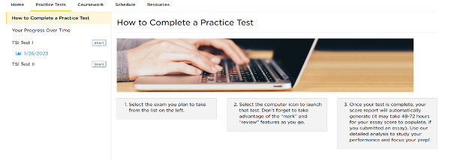
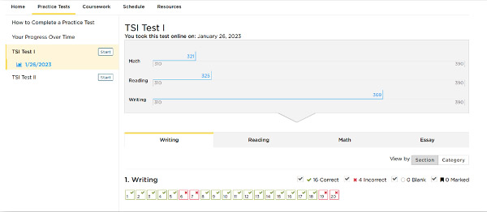
Practice Tests
Your TSI course includes practice tests to help you measure your readiness for college-level courses.
If you are unsure how to start, check out How to Complete a Practice Test.
Once you have completed a test, your results will be auto populated to your Practice Test tab.
View each test section by using the different tabs. Your results for that section will appear.
Hover over incorrect answers to see
explanations and concepts tested.
Toggle

Slide 6
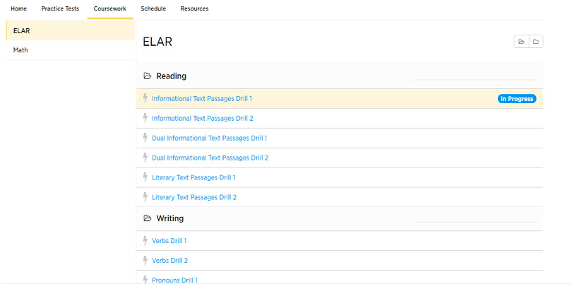
Coursework
Your coursework contains many drills to help you focus on specific subtopics found on the SAT and ACT.
Drills can be paused, ended early and retaken. Your scores on the drills will auto populate as well.
!
PRO TIP:
Diligent and consistent coursework completion is a key element to test prep improvement!
.

Slide 7
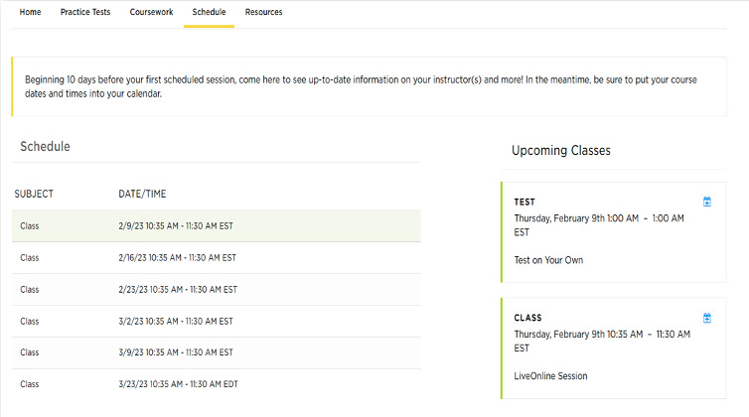
Course Schedule
Your course schedule is on your Home page and also on your schedule tab.
If you have LiveOnline class sessions, the Launch Class link will become active 15 minutes before the class start time. 24-48 hours after an online class session has ended, Class Recording and Class Slides links will appear.
If your sessions are in-person you will see the facility listed.

Slide 8
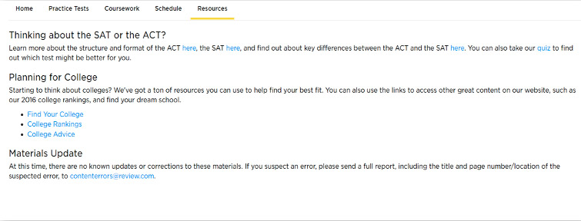
Resources
The Resources tab contains information on the SAT and the ACT, Tips about Planning for College, and Materials Update.
Come here to learn about the structure of the ACT and SAT, the differences and a quiz to help you determine which test is best for you.
You can also check here to see if any changes have been made to your course
materials.

Slide 9
LiveOnline Class Troubleshooting
If your class sessions are online, you will see LiveOnline listed within the class session on the schedule. The LiveOnline class link will appear 15 minutes before your class begins.
You may need to refresh your browser or sign out and back in if a link has not appeared yet.
Make sure you are ready for your LiveOnline class!
Browser Requirements and Set Up:
https://www.princetonreview.com/help/system-and-browser-requirements
Student Online Classroom FAQs + Troubleshooting:
https://www.princetonreview.com/help/tpr-classroom-troubleshooting
!
The trademark holders are not affiliated with The Princeton Review or products. The Princeton Review is not affiliated with Princeton University.

